Slide 1
HTML Structure
Tutorial #2

Slide 2
OBJECTIVE

Slide 3
Objective
This tutorial demonstrates the general structure of an HTML document and illustrates some of the most important tags.

Slide 4
TEXTPLANATION

Slide 5
Textplanation
HTML tags are designed to give the page a certain look and feel. Back in the old days, HTML did a whole lot of looking and feeling, but most of that's been ported over to CSS. Still, knowing how to use HTML to create a general layout is essential to the health and well being of your page.

Slide 6
Textplanation
There are 2 types of HTML elements that we should know about. If you know which is which, it'll save you from a handful of unpleasant surprises when testing.
Block Elements take up a whole line. It doesn't matter what’s in it. It can be just one letter. It’s the whole line.
Inline Elements take up only as much space as their content.

Slide 7
CONSTRUCTION

Slide 8
Construction
Let’s play around with some of the essential tags and other HTML goodies that are available to you.

Slide 9
Construction
Create a folder somewhere on your drive and label it HTML Structure.
Open up notepad++.
Save the empty file to your folder and name the file “index.html”.
All first pages on a website are called index.
As you go through the images of the construction, add to your code. You will see comments with explanations of what you are doing. Those comments will change with each slide. You should not type my comments into your code.

Slide 10
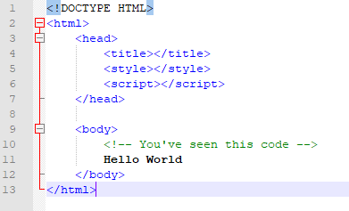
Construction

Slide 11
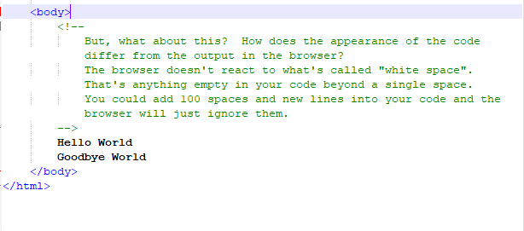
Construction

Slide 12
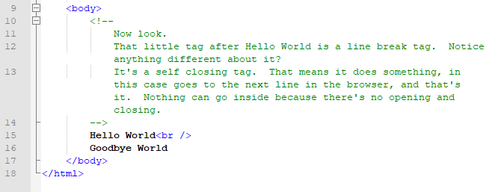
Construction

Slide 13
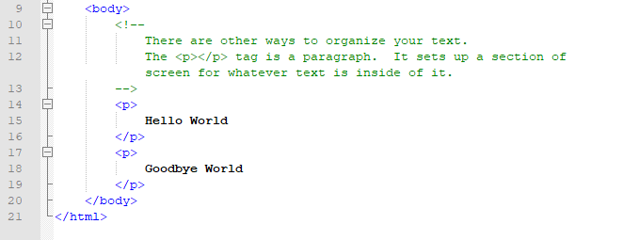
Construction

Slide 14
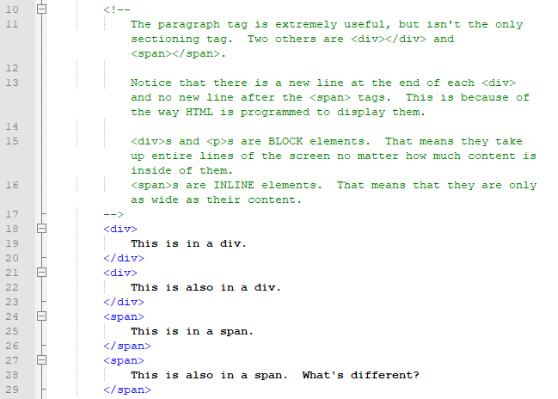
Construction

Slide 15
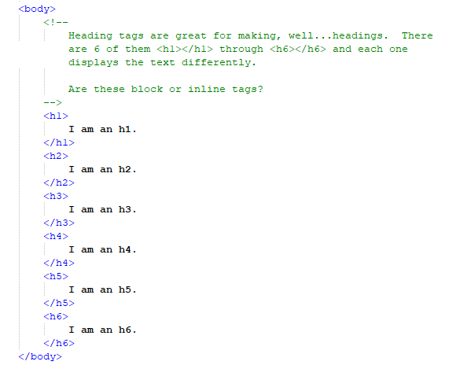
Construction

Slide 16
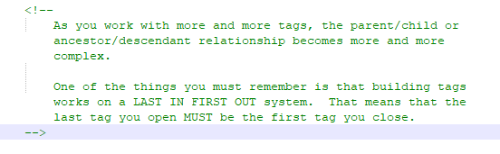
Construction

Slide 17
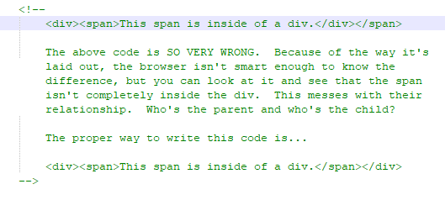
Construction

Slide 18
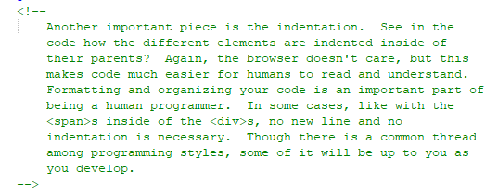
Construction

Slide 19
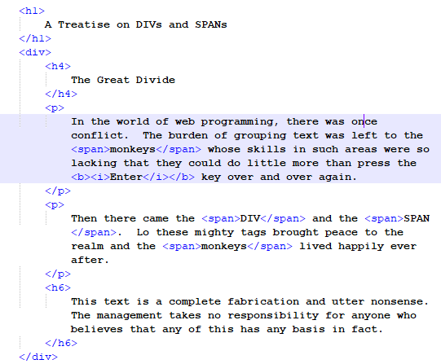
Construction

Slide 20
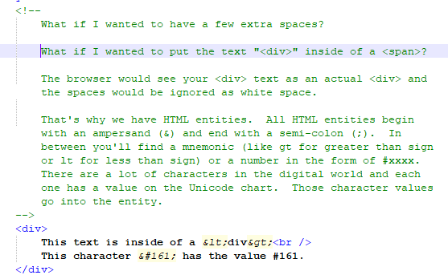
Construction

Slide 21
A DEEPER MEANING

Slide 22
A Deeper Meaning
The concept of block and inline elements may be simple enough on the surface, but the field gets a bit muddied when you start moving things around with CSS..

Slide 23
A Deeper Meaning
The most important thing to understand is that your HTML code directs the flow of output. When you were completing the construction portion of this tutorial, you may have noticed that the elements you put into your code appeared on screen from left to right and then down (depending on whether they were inline or block and how much content there was). This is because all of your elements have static positioning.

Slide 24
A Deeper Meaning
The word static, at least in the computer world, basically means that nothing changes. From code to execution, something static will execute the same way every time. Its arch nemesis is the word dynamic. Something that's dynamic may have different results depending on different conditions. You'll be hearing a lot about the many adventures of static and dynamic over the course of these tutorials.

Slide 25
A Deeper Meaning
Static positioning means exactly what you've seen. Your elements appear on screen exactly as they appear in your code. You may have guessed that there are ways to dynamically position your elements, but that information is a little too volatile for you right now. That’s kind of advanced CSS so you’d best not ask about now. Let’s just get used to putting things in order for the time being.

Slide 26
FAQ

Slide 27
FAQ
The <span> doesn’t do anything. Why would I ever want to use it?
Patience, young jedi. Patience.

Slide 28
FAQ
How do I center the text, change the color, change the font?
Relax. All of these things are done through CSS. Beware of old HTML that can have these effects, but is deprecated. The most common HTML tags that you should never use are <CENTER>, <FONT>, <U>, <STRONG>, <EM>, and most especially <MARQUEE>. These are all deprecated.

Slide 29
FAQ
How can I position elements dynamically?
You were specifically instructed not to ask that question.

Slide 30
ACTIVITY

Slide 31
A Children’s Story
Take a children’s story (any story that you know or want to make up) and put it into a web page. Use HTML elements to differentiate between the title of the book, the author of the book, each paragraph, and each physical page of the book.

